Slide 1
Real time System: CPU scheduling
Real-Time Systems: Real time system characteristics and kernel features, Implementing real-time operating system, real-time CPU scheduling.

Slide 2
Overview
System Characteristics
Features of Real-Time Systems
Implementing Real-Time Operating Systems
Real-Time CPU Scheduling

Slide 3
Introduction
A real-time system requires that results be produced within a specified deadline period
An embedded system is a computing device that is part of a larger system (I.e. automobile, airliner)
A safety-critical system is a real-time system with catastrophic results in case of failure

Slide 4
Hard Vs Soft RTS
A hard real-time system guarantees that real- time tasks be completed within their required deadlines.
A soft real-time system provides priority of real-time tasks over non real time tasks"
Periodic and aperiodic tasks."
Starting deadline/ completion deadline."

Slide 5
RTS Characteristic
Single purpose
Small size
Inexpensively mass-produced
Specific timing requirements

Slide 6
RTS Characteristic
Many real-time systems are designed using system-on-a-chip (SOC) strategy.
SOC allows the CPU, memory, memory-management unit, and attached peripheral ports (i.e., USB) to be contained in a single integrated circuit.

Slide 7
Real Time Kernels
Most real-time systems do not provide the features found in a standard desktop system
Because:
Real-time systems are typically single-purpose
Real-time systems often do not require interfacing with a user

Slide 8
Implementing Real-Time Systems
In general, real-time operating systems must provide:
Preemptive, priority-based scheduling.
Preemptive kernels.
Latency must be minimized

Slide 9
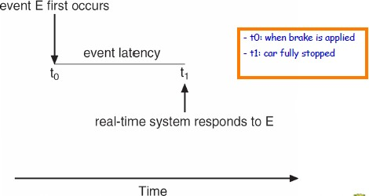
Minimizing Latency
Event latency is the amount of time from when an event occurs to when it is serviced

Slide 10
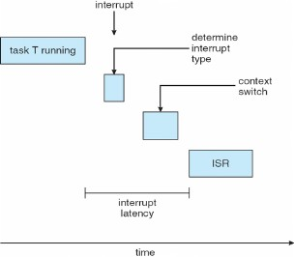
Interrupt Latency
Interrupt latency is the period of time from when an interrupt arrives at the CPU to when it is serviced

Slide 11
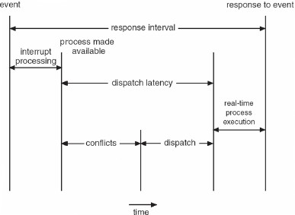
Dispatch Latency
Dispatch latency is the amount of time required for the scheduler to stop one process and start another"

Slide 12
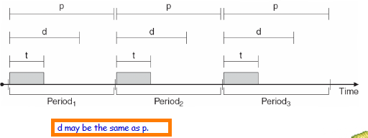
RTS scheduling
How to schedule the Tasks such that given timing constraints are satisfied?

Slide 13
Task models
Non periodic/Aperiodic (three parameters)
A: arriving time
C: computing time
D: deadline (relative deadline)
Timing constraints: deadline for each task,
Relative to arriving time or absolute deadline

Slide 14
Scheduling Problem
Given a set of tasks (ready queue)
Check if the set is schedulable
If yes, construct a schedule to meet all deadlines
If no, construct an optimal schedule e.g. minimizing response times

Slide 15
Tasks with the same arrival time
Assume a list of tasks
(A,C1, D1)(A,C2, D2) ...(A,Cn,Dn) that arrive at the same time i.e. A
How to find a feasible schedule?
(there may be many feasible schedules)

Slide 16
Earliest Due Date first (EDD) [Jackson 1955]
EDD: order tasks with non-decreasing deadlines.
Simple form of EDF (earliest deadline first)
– Example: (1,10)(2,3)(3,5)
– Schedule: (2,3)(3,5)(1,10)
FACT: EDD is optimal
If EDF cann’t find a feasible schedule for a task set, then no other algorithm can, i.e. The task set is non schedulable.

Slide 17
Tasks with different arrival times
Assume a list of tasks
– S= (A1,C1, D1)(A2,C2, D2) ...(An,Cn,Dn)
Preemptive EDF [Horn 1974]:
Whenever new tasks arrive, sort the ready queue according to earliest deadlines first at the moment
Run the first task of the queue if it is non empty

Slide 18
Earliest Deadline First Scheduling
Priorities are assigned according to deadlines:
the earlier the deadline, the higher the priority;
the later the deadline, the lower the priority

Slide 19
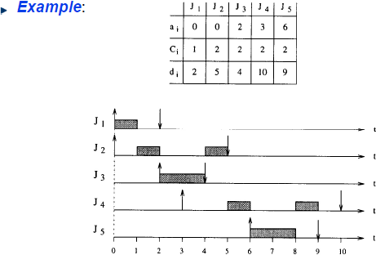
EDF: Example

Slide 20
Least slack scheduling
similar to shortest remaining time scheduling with the concept of a deadline thrown in.
pick the process that we can least afford to delay.
Least slack is computed as the time to the deadline minus the amount of computation.
For example, suppose that our remaining computation time, C, is 5 msec. and the deadline, D, is 20 msec from now. The slack time is D - C, or 15 msec.
The scheduler will compare this slack time with the slack times of other processes in the system and run the one with the lowest slack time.

Slide 21
Least Slack Time scheduling
With earliest deadline, we will always work on the process with the nearest deadline, delaying all the other processes.
With least slack scheduling, we get a balanced result in that we attempt to keep the differences from deadlines balanced among processes.

Slide 22
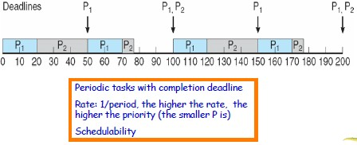
Rate Monotonic Scheduling
priority is assigned based on the inverse of its period (its rate)"
Shorter periods = higher priority;"
Longer periods = lower priority“
P1 is assigned a higher priority than P2.

Slide 23
Thank You

